Slide 1

LISTINGS 123
Bridge to the Company’s future growth

Slide 2

THE PROBLEM
Listings 123 doesn’t have a guide specific to Listings 123 that teaches potential hosts how to succeed with their first listing(s), and current hosts on how to better succeed with their existing listing(s).

Slide 3
TASKS PERFORMED
An Analysis of Raw Sample Data of Listings 123 Hosts and Guests

Slide 4
WHAT TO DO
Thorough analysis of the Data show a positive association between certain specific host traits and high customer satisfaction/repeat hostings
Based on these findings, we recommend that potential and current hosts do the following:

Slide 5
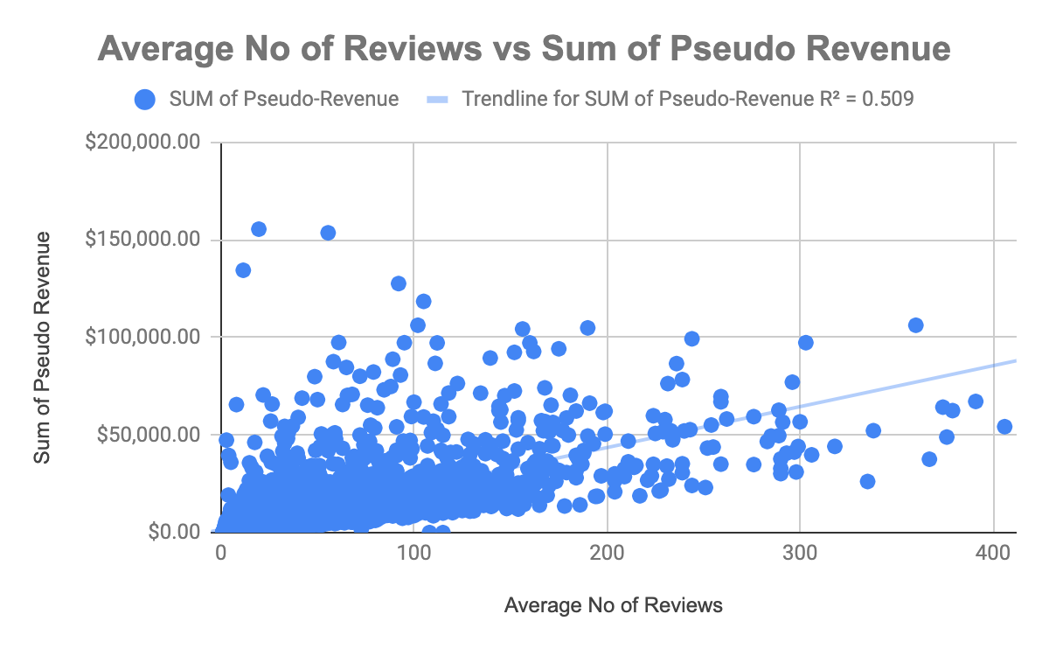

(Recommendation 1)
Boost Your Reviews
Data shows a strong relationship between No of Reviews and success on the site.
(Insert Visual Here)

Slide 6
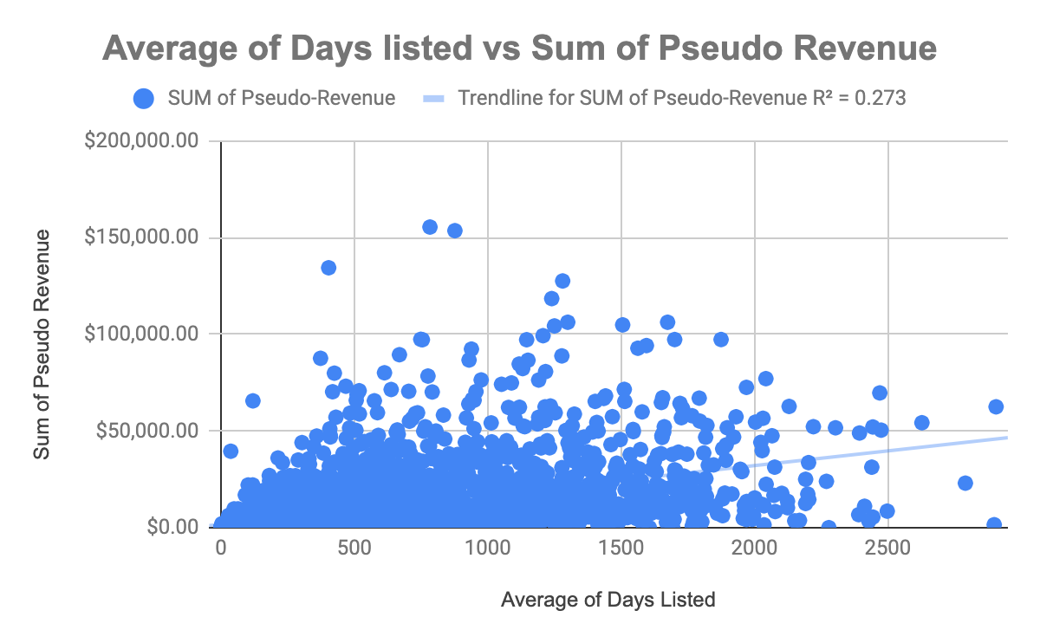
(Recommendation 2)
Keep your Listings on the Portal for at least 41 days
Data shows a strong relationship between average of days listed and success on the site.
(Insert Visual Here)

Slide 7
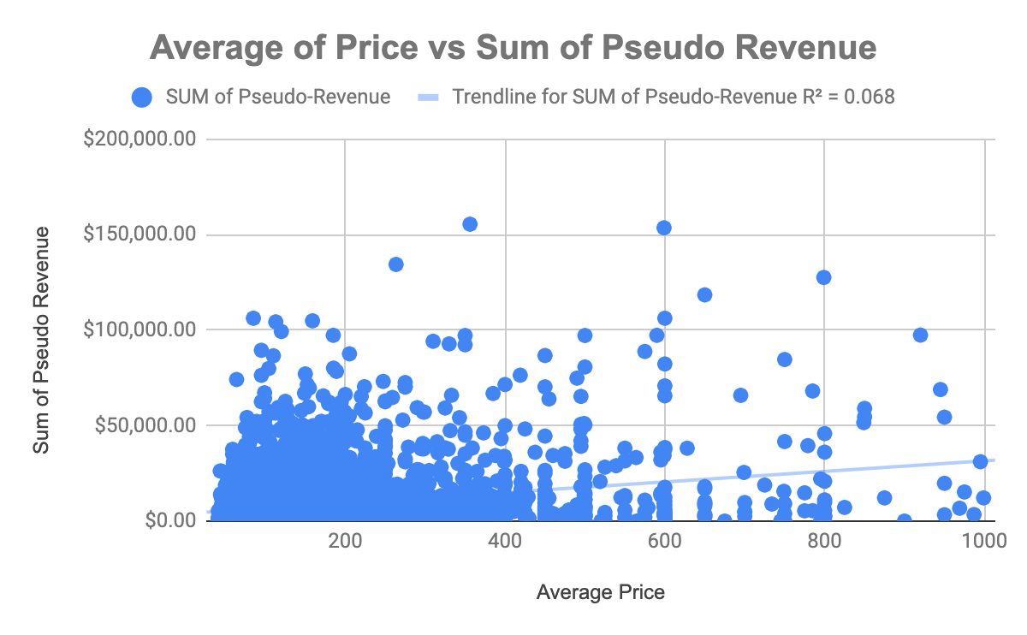
(Recommendation 3)
Charge Guests Reasonably.
Recommended listing price: $80 -$100
Data shows a relationship between average of price and success on the site.
(Insert Visual Here)

Slide 8
POTENTIAL NEXT STEPS
Nationwide Marketing Campaign
Company needs to conduct a Nationwide Marketing Campaign that would show the value and benefits of being a host. This proposed Campaign would market a guide to current and potential hosts.

Slide 9
ADDITIONAL RESOURCES REQUIRED TO COMPLETE NEXT STEPS
Money to fund the Nationwide Marketing Campaign.

Slide 10
VALUE OF THE MARKETING CAMPAIGN
The proposed Marketing Campaign would help the company expand into new cities thereby generating long term growth for the Company.

Slide 11
VALUE OF THE MARKETING CAMPAIGN
WIN-WIN FOR ALL PARTIES INVOLVED
LISTINGS 123 - INCREASED REVENUE
HOSTS - INCREASED INCOME
GUESTS - ENHANCED USER EXPERIENCE (I.E LOW PRICES)

Slide 12
VALUE OF THE MARKETING CAMPAIGN
WIN-WIN FOR ALL PARTIES INVOLVED
LISTINGS 123
GROWTH
GUESTS
HOSTS

Slide 13

THE END
THANK YOU ALL FOR WATCHING AND LISTENING

